Slide 1
FLOOD DETECTION AND PREVENTION USING HYDRAULIC STRUCTURES
INNOVATIVE PROJECT
ISHANK SINGH (2K20/CE/72)

Slide 2



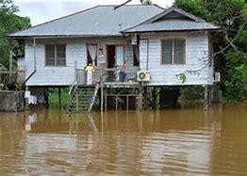

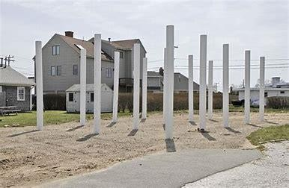
IDEA FOR THE
INNOVATION
Stilt houses are residential structures raised on an elevated platform. These are most popular in environmentally- sensitive regions. Read on to learn more about the structure of stilt homes, its popularity across the world and more
Most commonly built in places that are prone to flooding, stilt houses are raised on stilts and are higher than a regular house. Regular homes are built on land but stilt houses use strong stilts, to avoid the risks of flooding or even pests and vermin.

Slide 3
STILT HOUSES : CONS
More expensive because of structural issues (large pilings, extra framing for wind resistance, etc.).
Those pilings can eventually get replaced - and it won't be low-cost.
A lot of step rise or a fashionable loading elevate.
A significant storm or flood event should still take the house out if it's unhealthy enough.
To Overcome these cons we proposed an innovative idea that could help in
prevention of floods and as well as early detection of floods

Slide 4
OUR INNOVATIVE IDEA
Detection – Using water level sensors
Alerting – Using piezo - buzzers present in every house .
Increasing the level of house using hydraulics which would be pushed using servo motors and structure comprised of wood and steel which would be controlled using various sensors , and would be used to to increase or decrease the level of platform / Houses

Slide 5
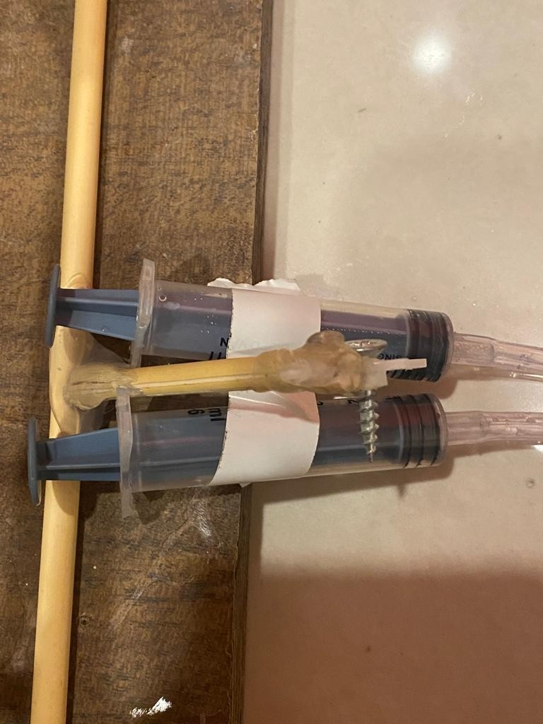
SYRINGES AS HYDRAULICS

Slide 6
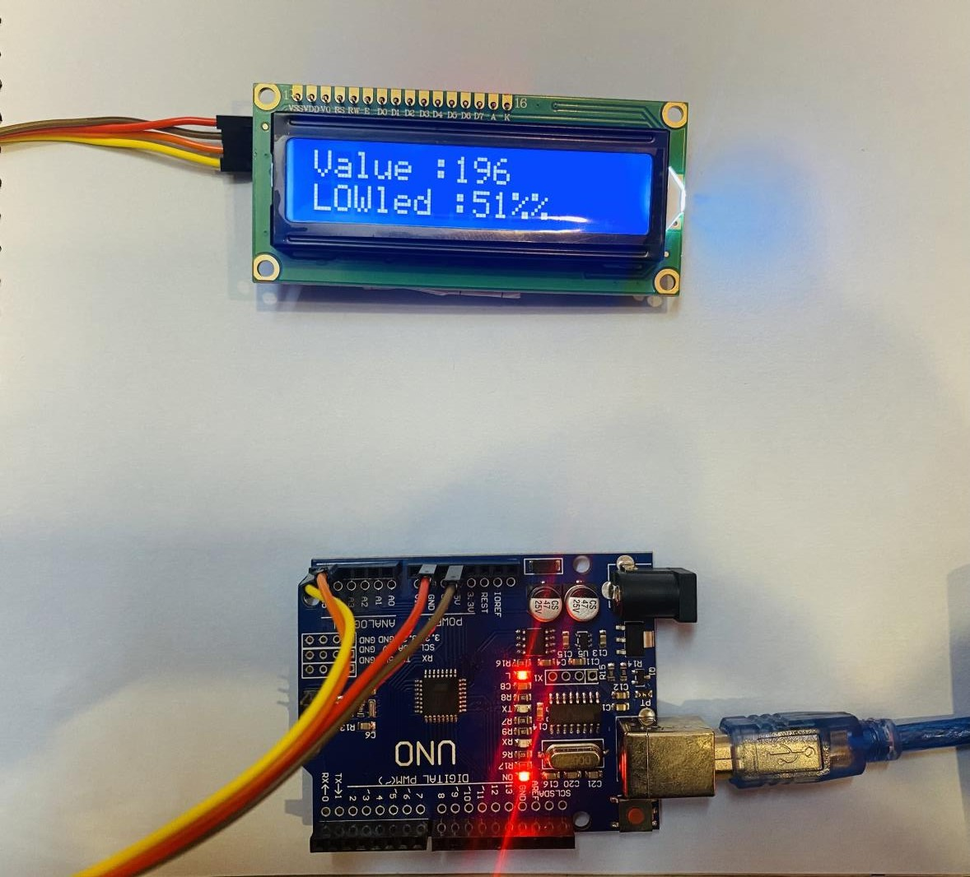
DETECTION
Our first step is to detect water level which is done using water level sensor , which detects various water levels
Using a 16 x 2 Bit DISPLAY AND A I2C module to display these levels to the user.

Slide 7
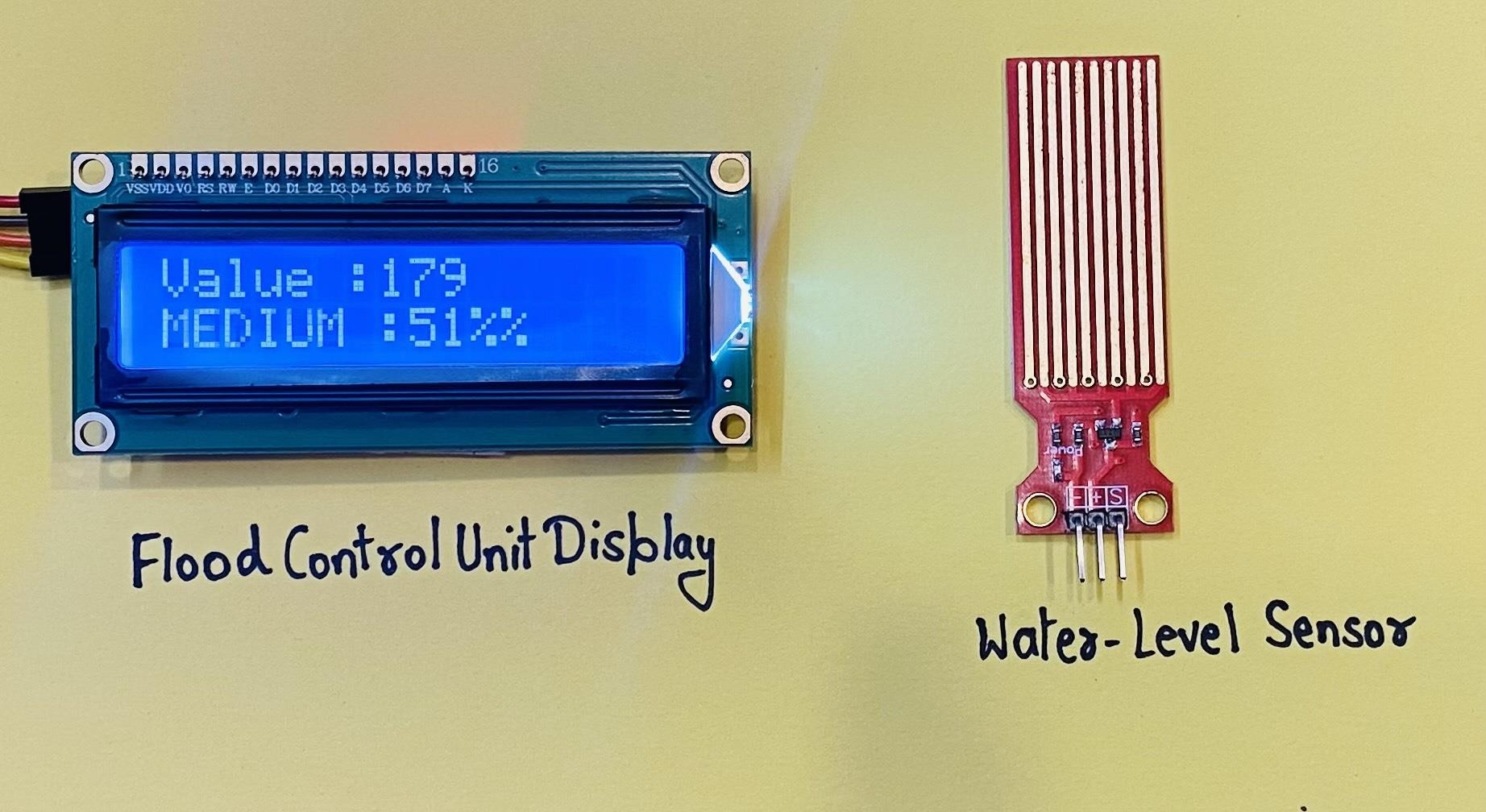
WATER SENSOR AND DISPLAY

Slide 8
ALERTING
To alert the people in the flood prone areas about increasing water levels we will use piezo-buzzer in every house .
We would link server with our circuit software so when the water starts to rise
above a critical level the people will receive warning messages .

Slide 9
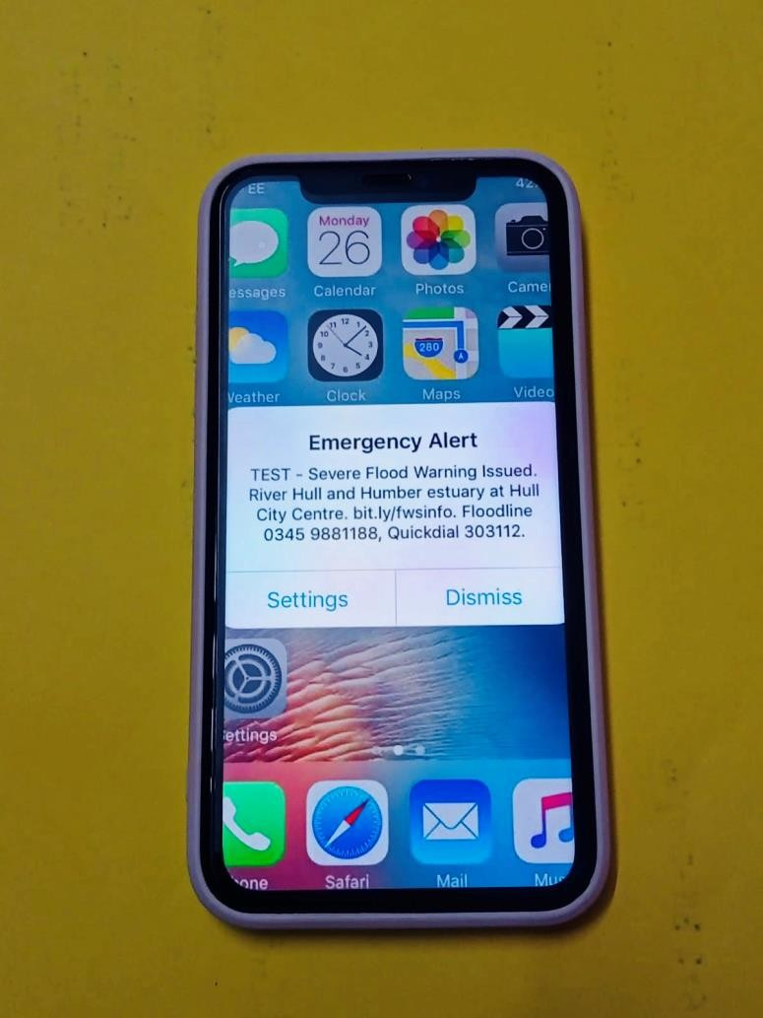

PIEZO – BUZZER & ALERTING MESSAGES

Slide 10
RAISING THE LEVEL OF THE PLATFORM USING SERVO-
MOTORS
When the water sensor detects water over a critical point the Arduino board starts rotating the servo motor which in turn pushes the hydraulics which helps the screw jack to rise.
The level of the rise of the platform could be determined by the user or the sensor , to an
adequate height which would prevent the house from flooding

Slide 11
WORKING PROTOTYPE
Scenario 1
When the water level is low , The display just reads the water level , BUZZERS OFF , platform not raised yet

Slide 12
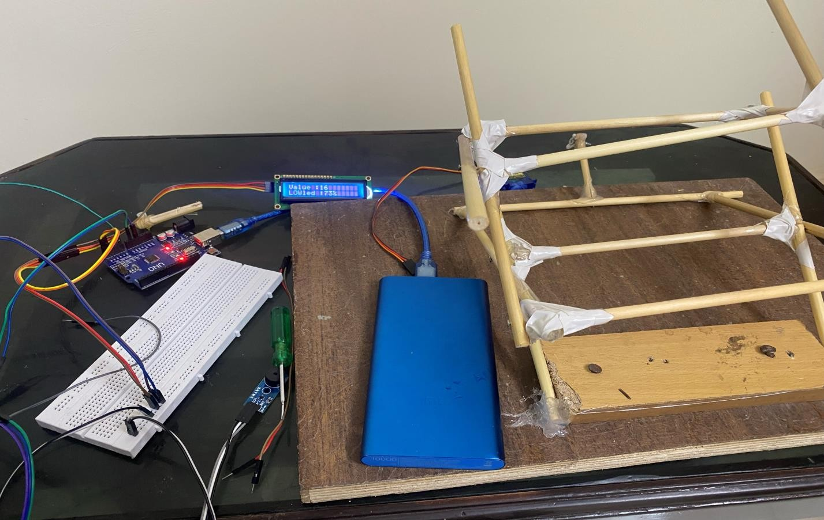
THE SETUP

Slide 13
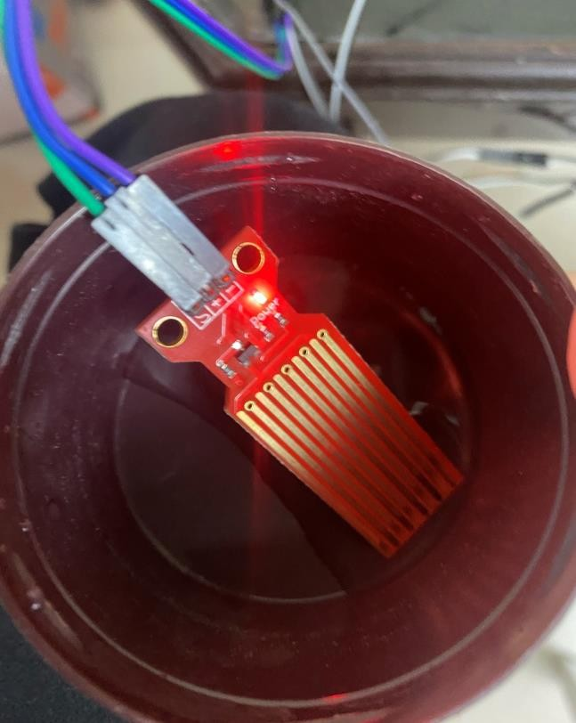
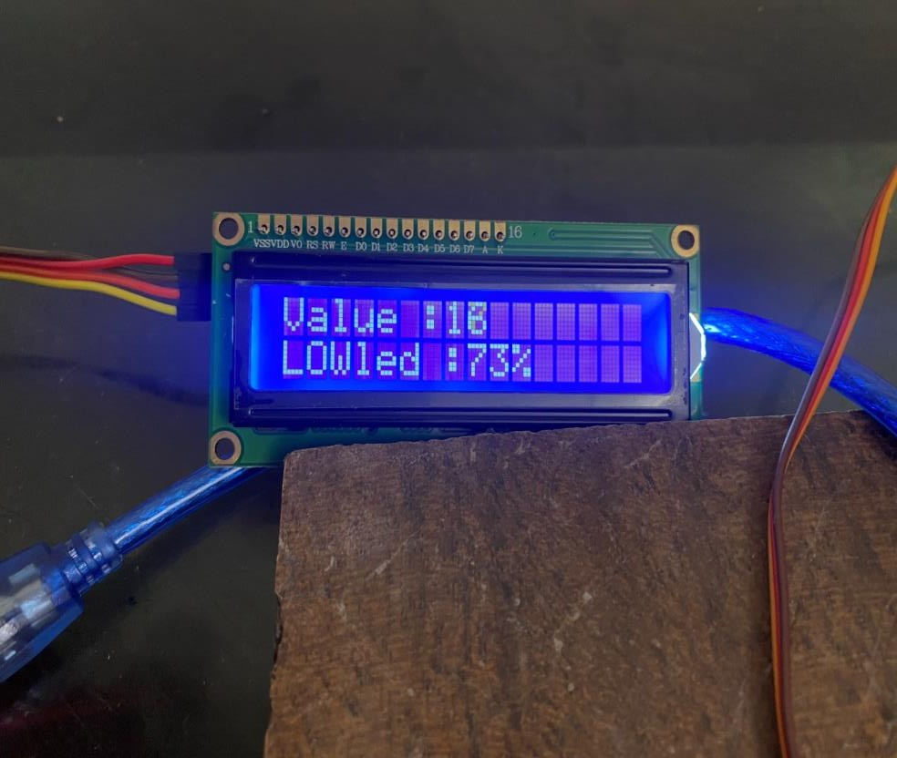
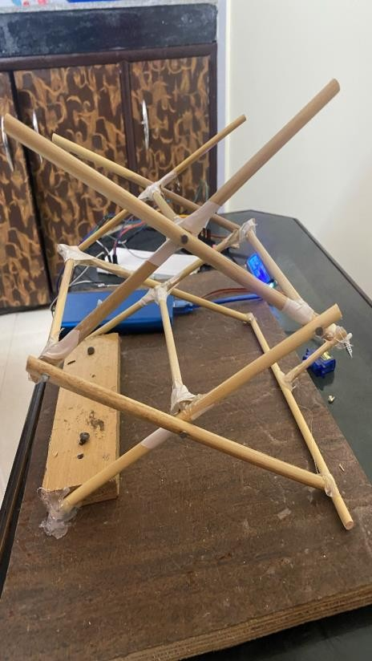
LOW WATER LEVEL , PLATFORM AT
LEVEL

Slide 14
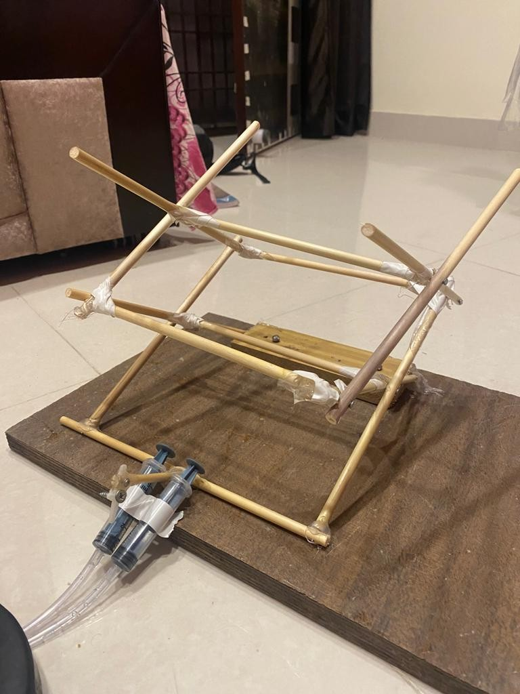
HYDRAULICS AT MEAN POSITION

Slide 15
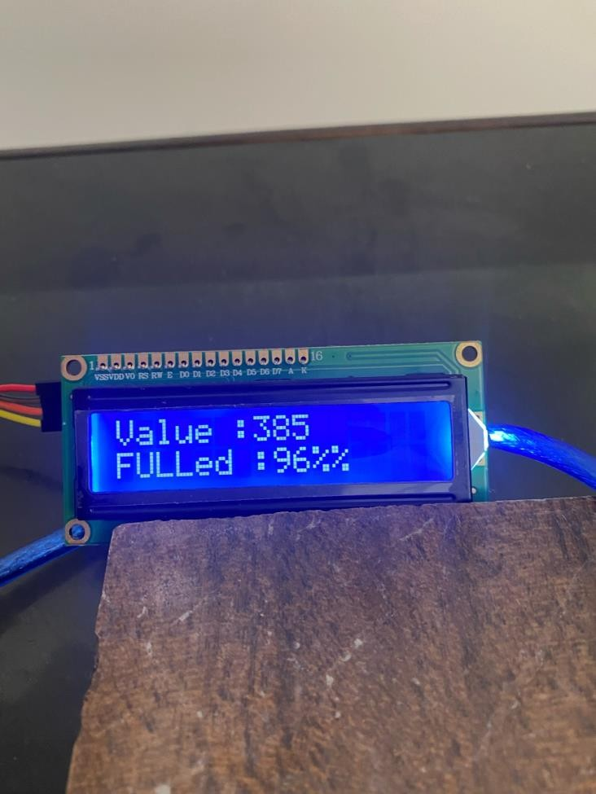
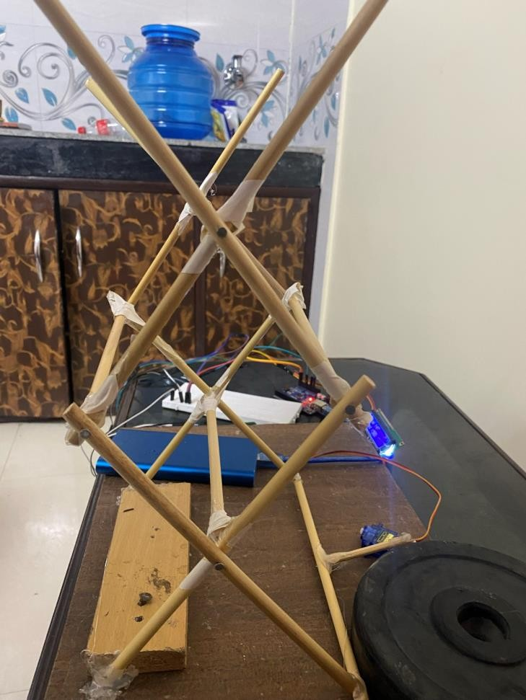
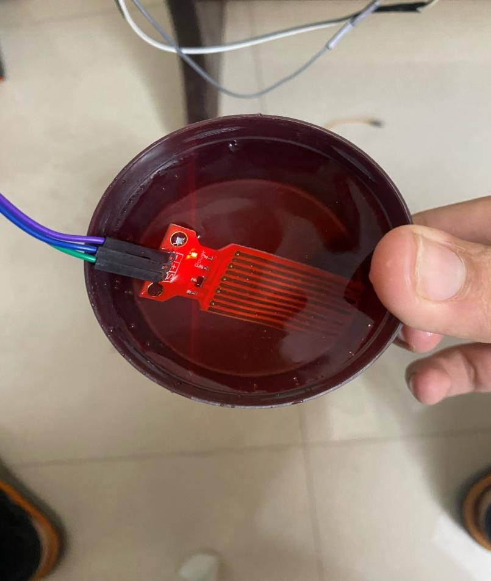
HIGH WATER LEVEL , PLATFORM
HEIGHT INCREASED

Slide 16
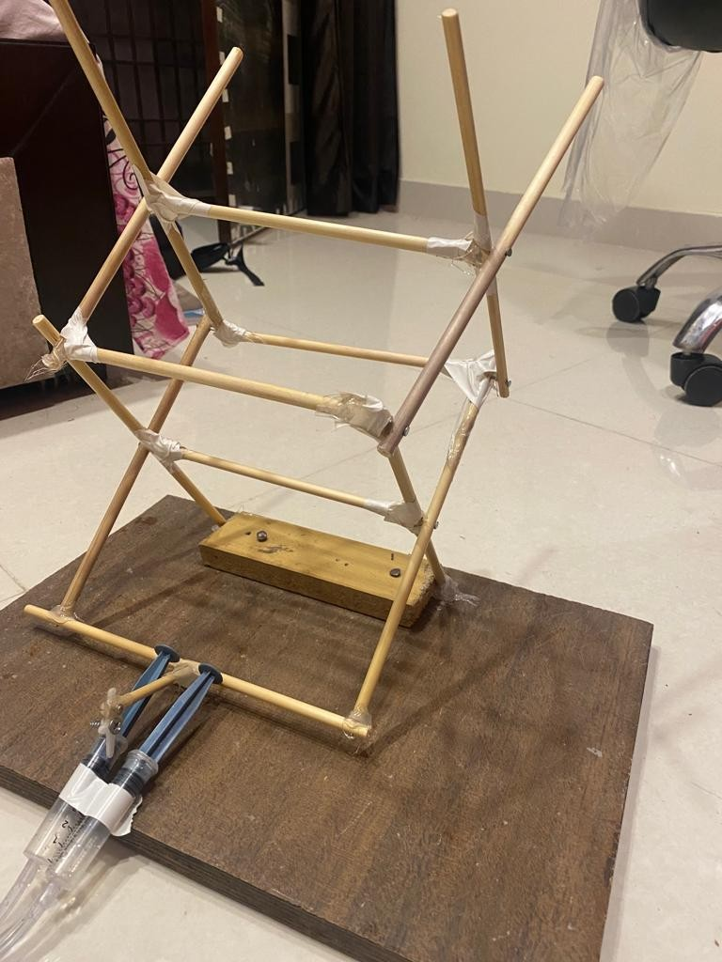
PLATFORM RAISED , HYDRAULICS ARE AT EXTENDED POSITION

Slide 17
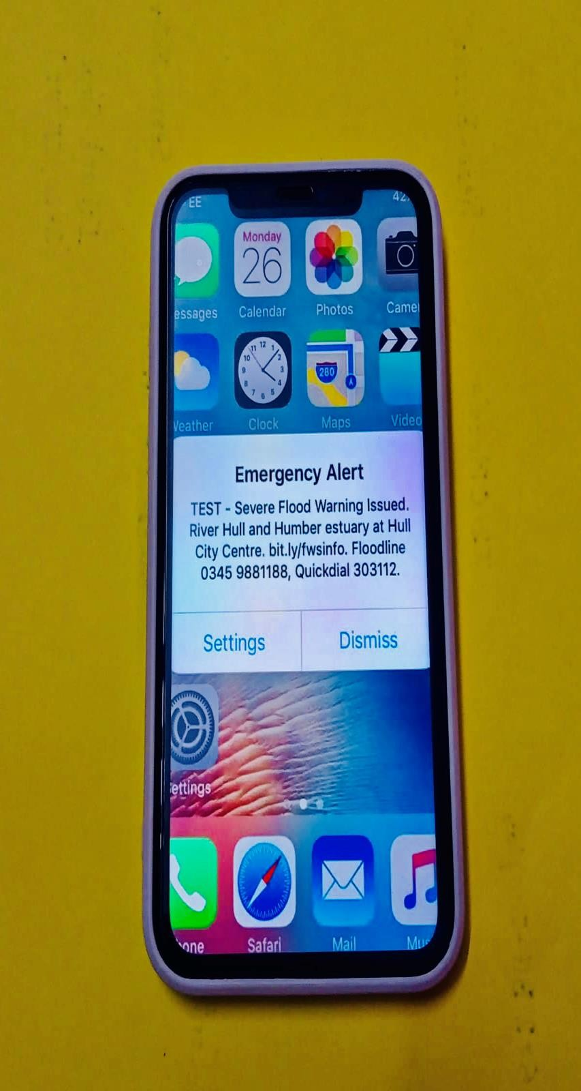
ALERT MESSAGE SENT TO THE
USER

